Slide 1
An ocean of untapped potential for new ingredients: are we ready?
Perspectives from the Bluecc project and relevant research
08.06.21
Themistoklis Altintzoglou
Senior Scientist, PhD

Slide 2
Norgeskart
Nofima on the map
Redigerbart i Powerpoint
For å fargelegge fylker, vis Valgrute, og velg fylket fra lista.
“Hjem”-fanen > “Ordne” > Valgrute...
Kopier stedsnavn, info, linjer og kartsymbol for å lage flere.
Tromsø
Headquarter
Seafood
Aquaculture
Sunndalsøra
Bergen
Aquaculture
Aquaculture
Ås
Stavanger
Food Science
Aquaculture
Seafood

Slide 3
Nofima in numbers
Projects
Customers from
employees
TURNOVER
618
28
391
661
in which Nofima is engaged
different countries
60% women and 40% men
171 have a PhD
Million NOK in 2020

Slide 4
Department of Marketing Research
Knowledge about markets and buying behaviour at consumer and industry level
Marketing and consumer research
Attitudes, preferences and habits
Industrial buying behaviours, dynamics and structure in marketing channels
Knowledge as a basis for developing of established and new markets
Market-based product development
Product development at the point of intersection between product and consumer
Consumer testing and evaluation of product concepts
Barriers and success criteria for product development
Market strategy
Branding and brand building
Positioning through differentiation, segmentation and niche choice
Choice of marketing channels
Notes:
4

Slide 5
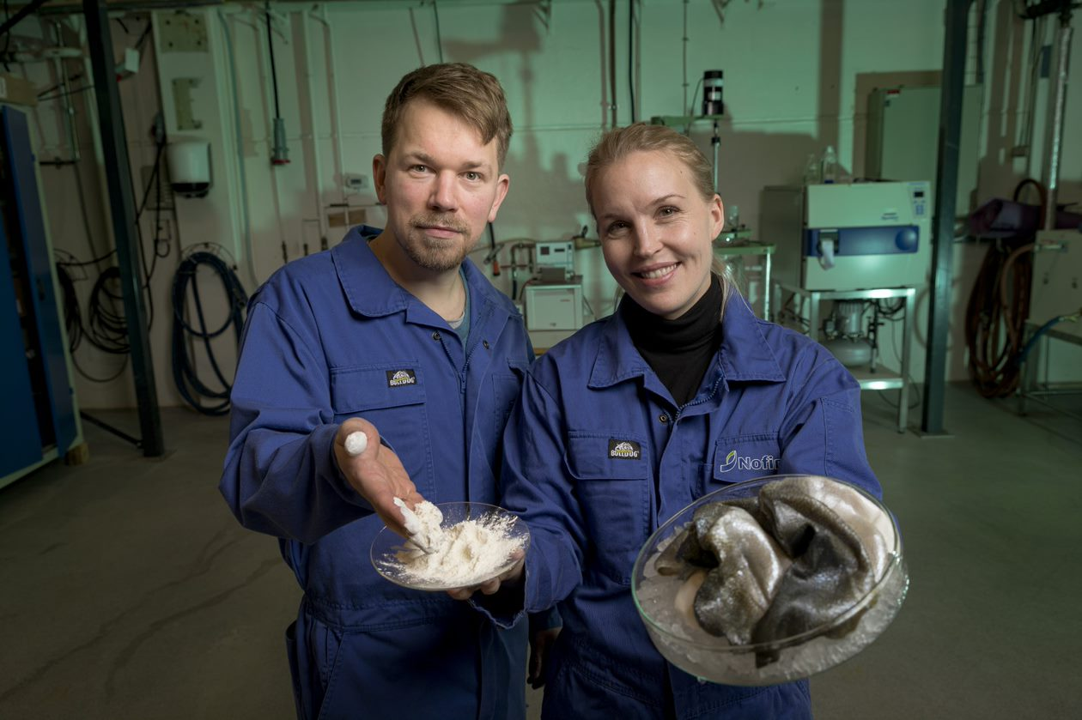
The project
Notes:
Runar og Kjersti from Nofima lead the project. You can contact them if you want to know more about the natural science part of the project ;)

Slide 6
BlueCC in short
Aim: Targeted use of underutlised marine species
138 million tonnes/year biowaste, up to 40% goes to landfill
By-catch from fisheries
Cleaner fish in aquaculture
Invasive marine species
Develop new eco-friendly marine ingredients in a market acceptance approach
Emphasis on market needs
Chitin from invasive crabs; Chinese mitten crab, blue crab, king crab, green crab
Collagen from the common jellyfish, common starfish and cleaner fish (lump fish, wrasse)

Slide 7
Partners

Slide 8
Market-driven Concepts
Nofima
Exploitation Team
CESAM Nofima
Pharmatec
Dissemination / Communication
Nofima
Chitin Demonstrator
ILVO
Research Team
ILVO UGhent Chalmers Fraunhofer CNR
Pharmatech
Project Manager
Nofima
UGhent
Exploitation Channels
Pharmatech clients – EU
Innovation Norway
Enterprise Ireland
Bord Bia - Ireland
SME Instrument – EU
Bluebio Value Accelerator
Blue Investor day – EU
Industry Clusters
Consumer Associations
Professional Social Networks
Bilateral industry meetings
Promotional Roadshows
Commercial Feasibility
CESAM
Collagen Demonstrator
Nofima
CNR
Fraunhofer
Characterisation of Bioactives
Fraunhofer
Health effects of novel Ingredients
Chalmers
Catalysts
Legasea marine cluster - Norway
Marine Institute – Ireland
University of Lisbon
Maritime Clusters in Portugal
BBI-JU - EU
Development Team
Nofima
Pharmatech CESAM
Notes:
You will see BBA is exchanged with CESAM
Market-driven concepts is the wp to guide commercial efforts
Does not mean we cannot start work on other wp’s

Slide 9
Notes:
Or on a more traditional supply chain kind of structure

Slide 10
WP on Market driven concept development
Themis Altintzoglou & Morten Heide
Nofima

Slide 11
WP1: Market driven concept development
Knowledge from BlueShell → Product concept elements (chitin, chitosan, collagen or collagen peptides)
Product concept elements → Consumers evaluate pictures of product concepts in an online survey
Tasks
1.1 Consumer insight to product concepts
1.2 Product concepts from marine ingredients
1.3 Recommendations for product development

Slide 12
WP1 Objectives
Main objective:
Define consumer demands for new healthy and sustainable products, based on sustainable marine ingredients.
Secondary objectives:
Translation of consumer insight to product concepts, designed based on sustainable marine ingredients, with a high potential for success in the market.
Identification of product concepts that consumers evaluate as most liked and would buy in the market.
Development of clear and easy to use recommendations for future development of products by the industry, after the end of the BlueCC project.

Slide 13
Task 1.1: Consumer insight to product concepts
Build on the output from BlueShell: how consumers perceive products that contain ingredients from a production that makes use of the whole raw material
Definition of product development elements used as ingredients for the product concepts in T1.2 and further analytical developments in WP2 and WP3.
How?
Consumer data from BlueShell organised and summarised with focus on product development in BlueCC.

Slide 14
Task 1.2: Product concepts from marine ingredients
T1.1 →
Product concept development elements →
Create realistic images of product concepts →
Tested on an experimental online survey →
Consumer feedback →
Concepts closer to what consumers like/buy in real market →
T1.3 define the potential uses of ingredients that are studied in the rest of the BlueCC WPs.
Survey (currently out and collecting data)
Establish the most liked product concepts
Which product elements and combinations function the best
Variables/measurements:
Experimental and liking variables
Social, demographic, behaviour and personality characteristics

